Slide 1


Learning, Evaluation & Analysis Platform
Overview

Slide 2
LEAP Problem Statement
3 problems:
Unstandardized databases complicated data usage
Deliverables, documents and dashboards uneven across projects
MERL pages not very “friendly”/useful
Capisc not sufficient for project needs
Since 2013, LEAP!
Notes:
Add a picture! ;)

Slide 3

LEAP conceptual framework

Slide 4
International Development – Time allocation
WHAT DONORS WANT
PRE-LEAP TIME SPENT
VALUE
OBTAIN
& CLEAN DATA
CALCULATE REQUIRED
DATA
OBTAIN
& CLEAN DATA
CALCULATE REQUIRED
DATA
OBTAIN
& CLEAN DATA
EXPLORE & LEARN
ORGANIZE AND STORE DATA
EXPLORE & LEARN
ORGANIZE AND STORE DATA
CALCULATE REQUIRED
DATA
ORGANIZE AND STORE DATA
EXPLORE & LEARN

Slide 5
Need to change how to invest time
Annual Survey
CALCULATE REQUIRED
DATA
CALCULATE REQUIRED
DATA
CALCULATE REQUIRED
DATA
CALCULATE REQUIRED
DATA
EXPLORE & LEARN
EXPLORE & LEARN
EXPLORE & LEARN
EXPLORE & LEARN
ORGANIZE AND STORE DATA
OBTAIN & CLEAN DATA
Annual Survey
ORGANIZE AND STORE DATA
CALCULATE REQUIRED
DATA
CALCULATE REQUIRED
DATA
CALCULATE REQUIRED
DATA
CALCULATE REQUIRED
DATA
EXPLORE & LEARN
OBTAIN & CLEAN DATA

Slide 6
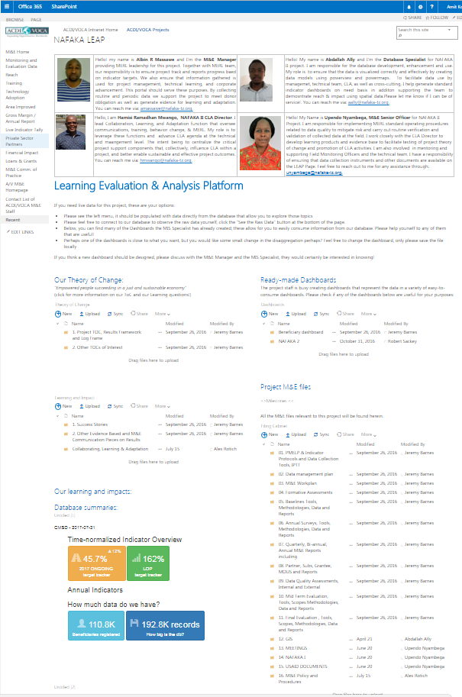

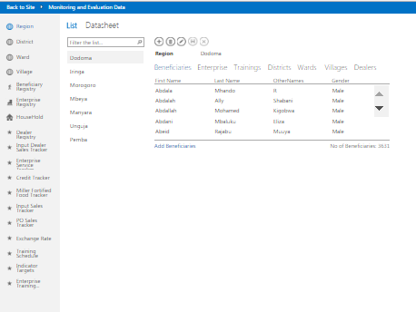
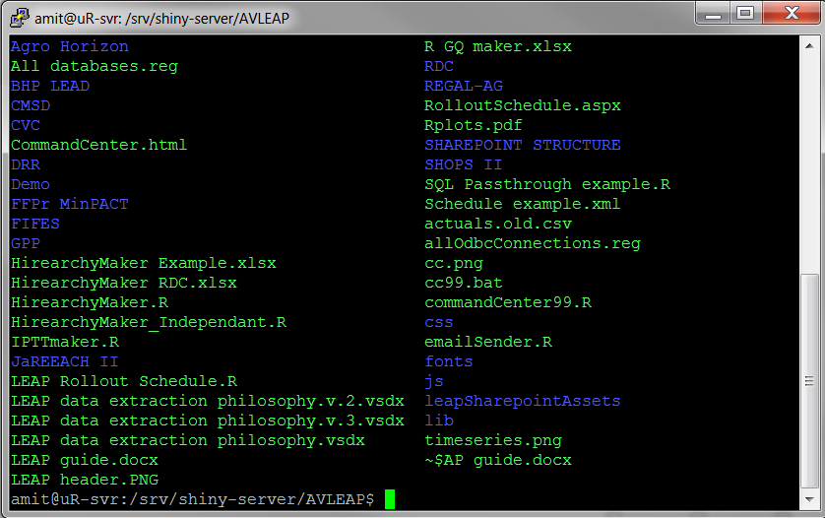
What is the LEAP strategy?
People = 10-day training + Remote support
Process = MERL Policy + Follow-up
Tools = Standard database + automated reports + SharePoint page

Slide 7
Learning, Evaluation & Analysis Platform (LEAP)
FACILITATES PROJECT MANAGEMENT
Standardized project management checks, facilitates adaptive management
AUTOMATES REPORTING REQUIREMENTS
Automatically generated IPTT
EXPOSES DIGESTED DATA
Adaptive management / data-driven leadership
EXPOSES RAW DATA
Corporate and cross-Project analysis & project cross-pollination
PROVIDES STANDARDIZED ASSET MANAGEMENT
Facilitates support, ensures audit compliance, insures against
staff turnover

Slide 8
WITH NO RAW DATA MANAGEMENT SYSTEM ☹
I theorize that
A ➔ B. Let me check
Indicators
PIRS
PMELP
ToC
Etc…
Oh well, at least I respected my PMELP
FAIL
WITH A WELL FUNCTIONING RAW DATA MANAGEMENT SYSTEM ☺
FRESH
LOOK
I theorize that
A ➔ B. Let me check
Huh… that’s interesting. I wonder if…
Indicators
PIRS
PMELP
ToC
Etc…
FAIL
THE ACTUAL DATA
ANALYSIS
WINS +
LEARNING!!

Slide 9
Raw data mgmt. example
Indicators:
Bens Trained:
- Actual = 5
- Target = 5
- Percent = 100%
Applied Tech:
- Actual = 3
- Target = 5
- Percent = 60%
Beneficiaries
Trained
Applied Tech
Near roads
data is not a reporting
obligation,
it’s an opportunity
Not-near roads
Gender? Age Group? Near Market? Near water? Local politics?

Slide 10
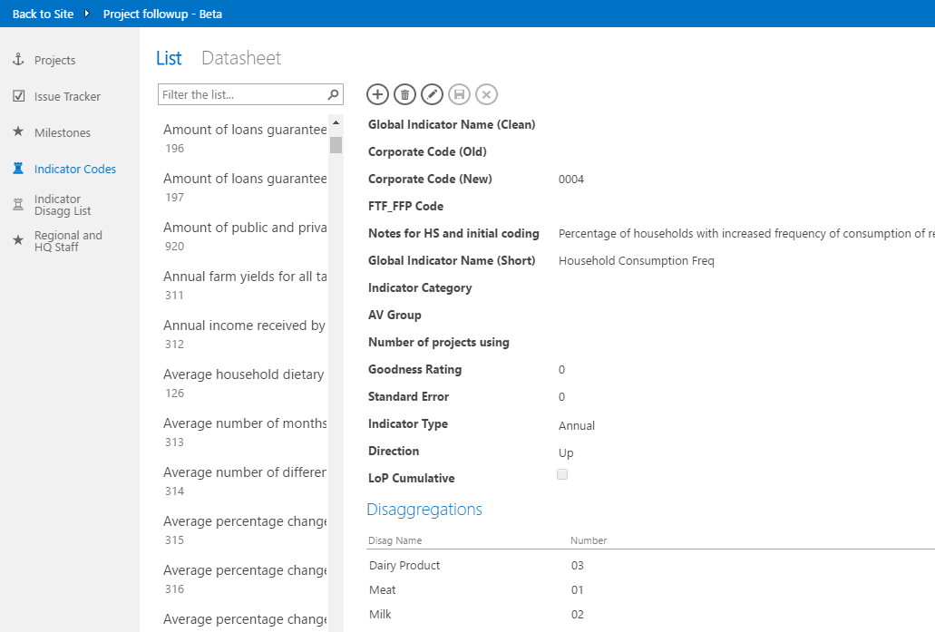
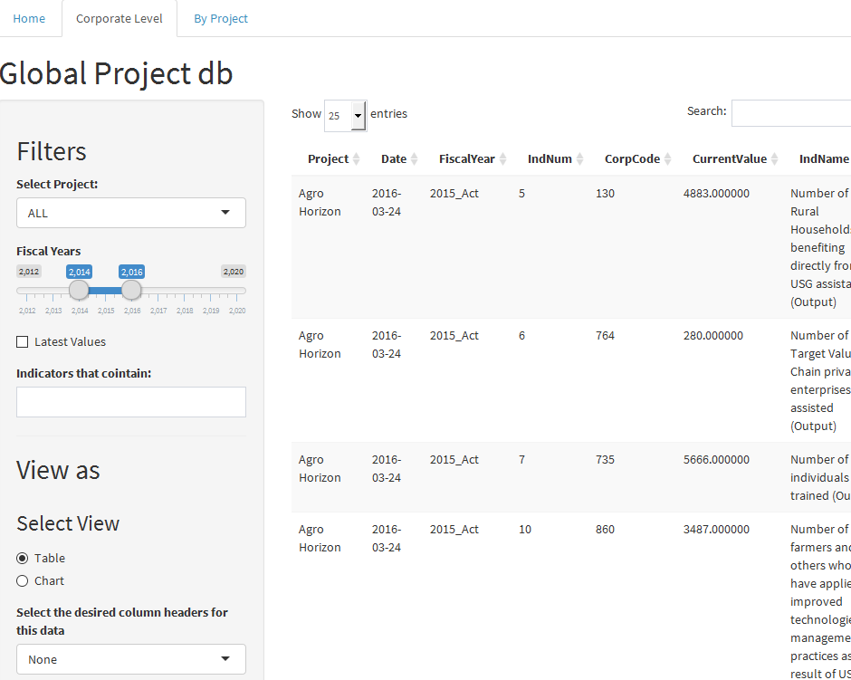

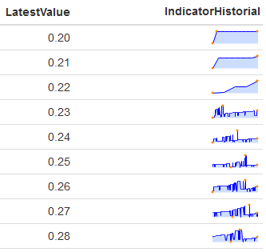
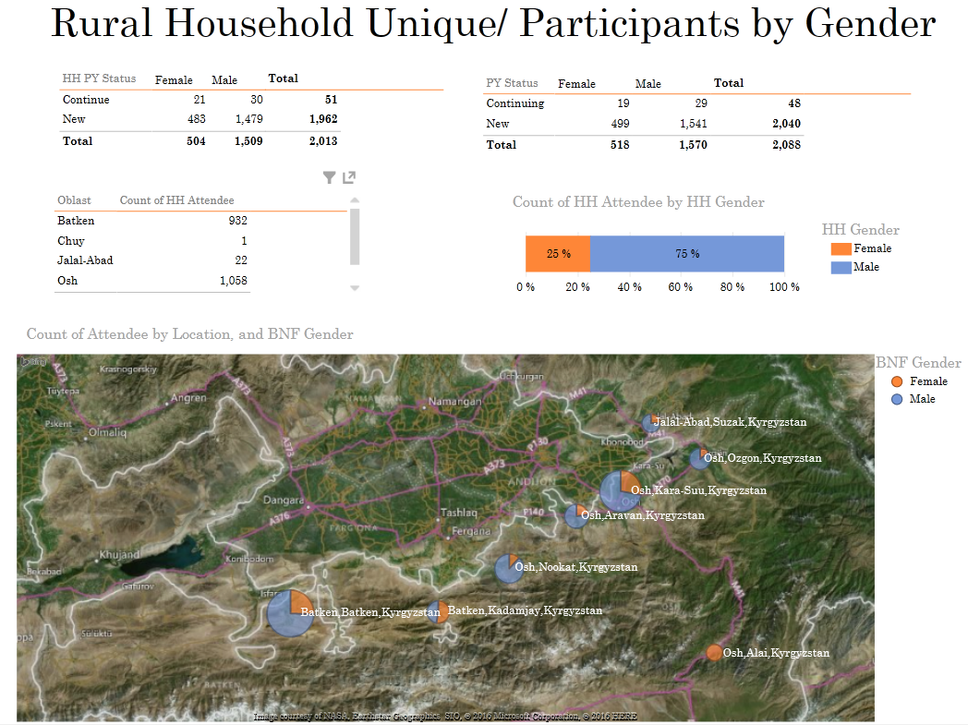
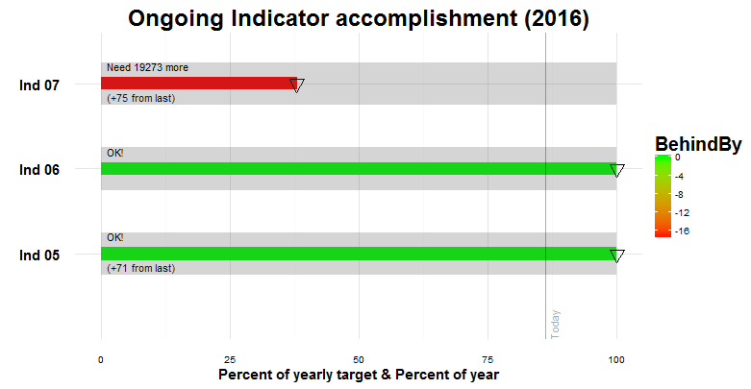
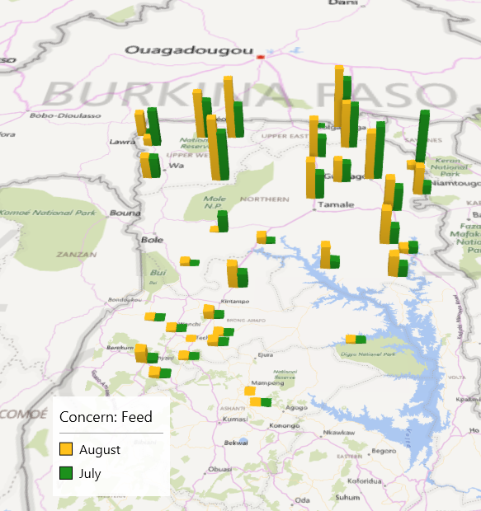
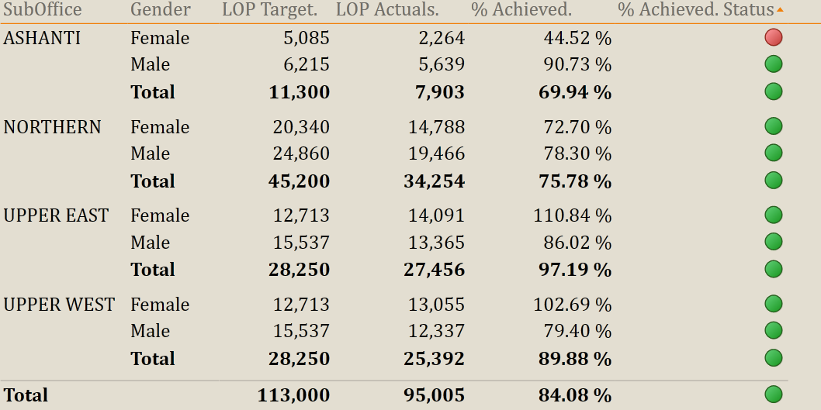
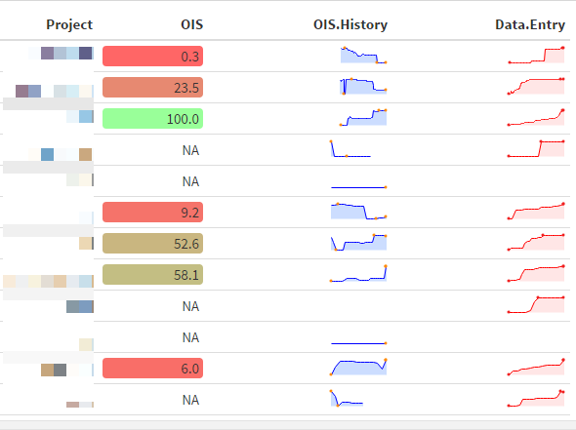
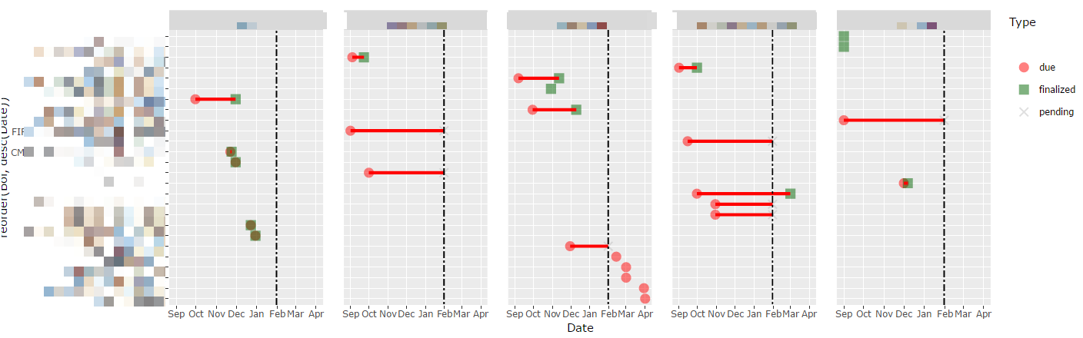
FULL
DETAILS
FAST &
EASY
RESPONSIBLE: PROJECT STAFF
RESPONSIBLE: REGIONAL STAFF
checks

Slide 11
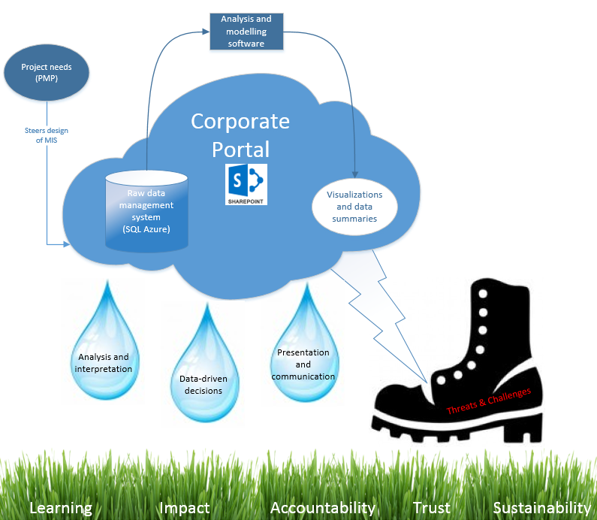

Slide 12



Global LEAP Leads
International M&E Specialists
Follow-up support
System QC and monitoring
Niri Ramasinjatovo
Senior Director MERL
Silimane Ngoma
Regional Director MERL
International MIS Specialists
Project Startup
Follow-on trips (on request)
Remote tech support
Upgrades/improvements
Jeremy Barnes
Amit Kohli
Director S
&
T
Director S
&
T
+ 27 Project experts!

Slide 13
Finding a project’s LEAP Site and description of LEAP Landing page

Slide 14
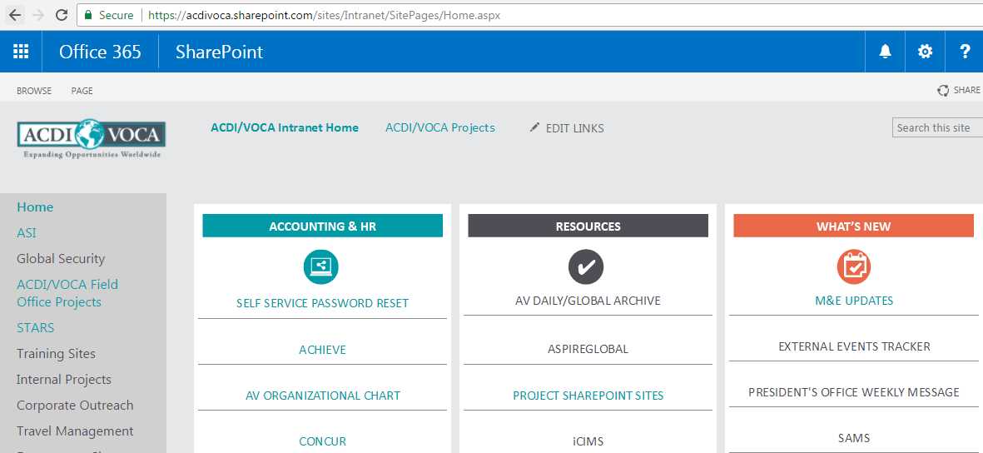
Finding a Project’s LEAP – AV Intranet
https://acdivoca.sharepoint.com/sites/Intranet

Slide 15
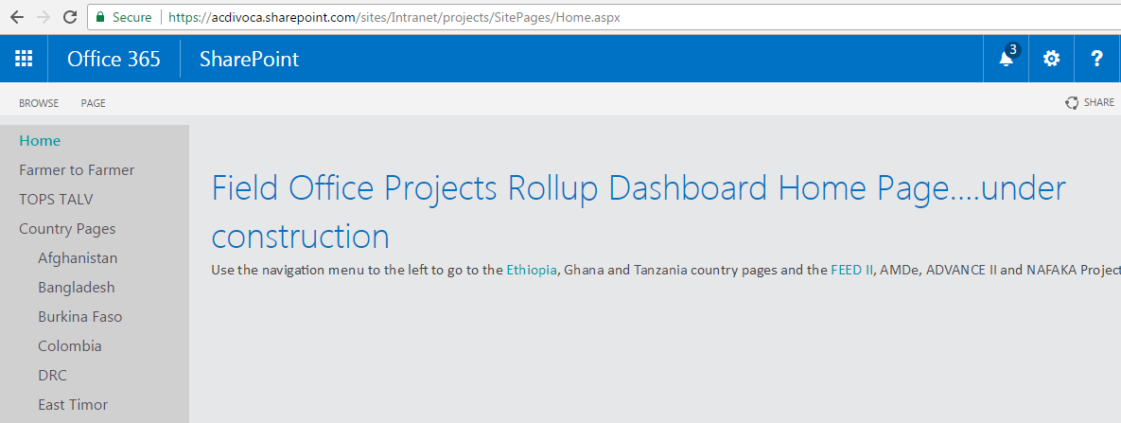
Finding a Project’s LEAP – Projects
Select the country
https://acdivoca.sharepoint.com/sites/Intranet/projects

Slide 16
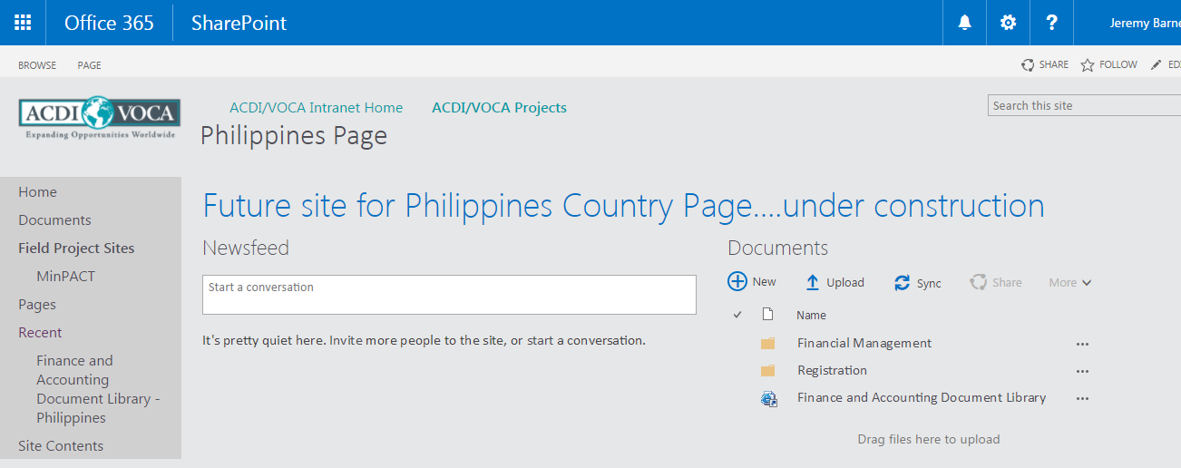
Finding a Project’s LEAP – Country Page
Select the project

Slide 17
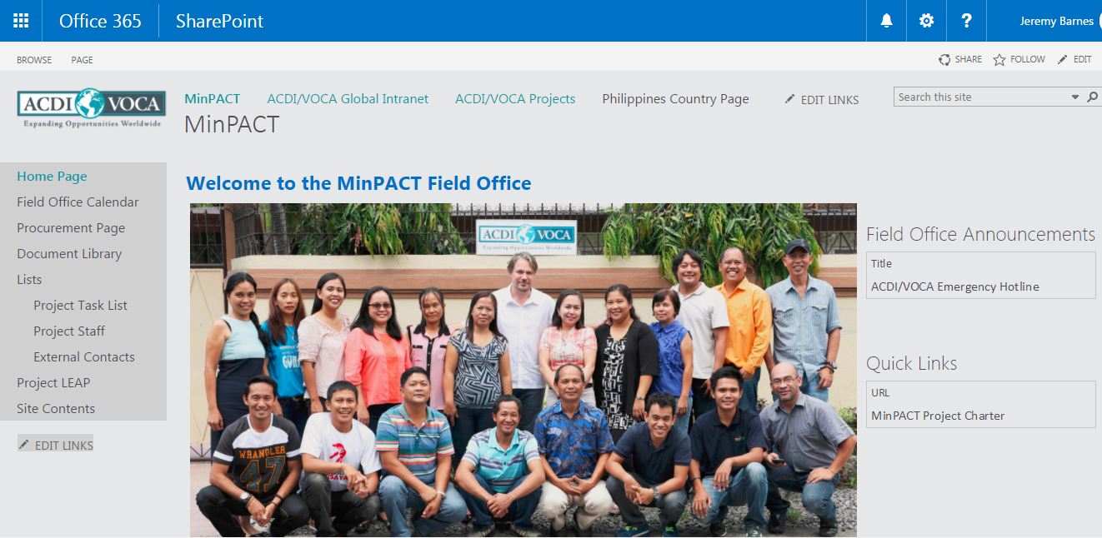
Finding a Project’s LEAP – Project Page
Click Project LEAP

Slide 18
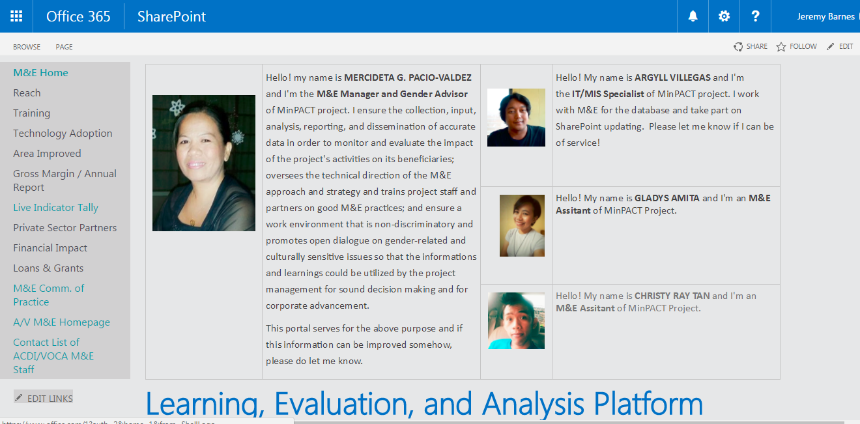
Project LEAP Landing Page

Slide 19
LEAP Landing Page – MIS Administrators
Responsible for:
Project M&E Data Management
Visualization & Analytics
Ad Hoc Queries

Slide 20
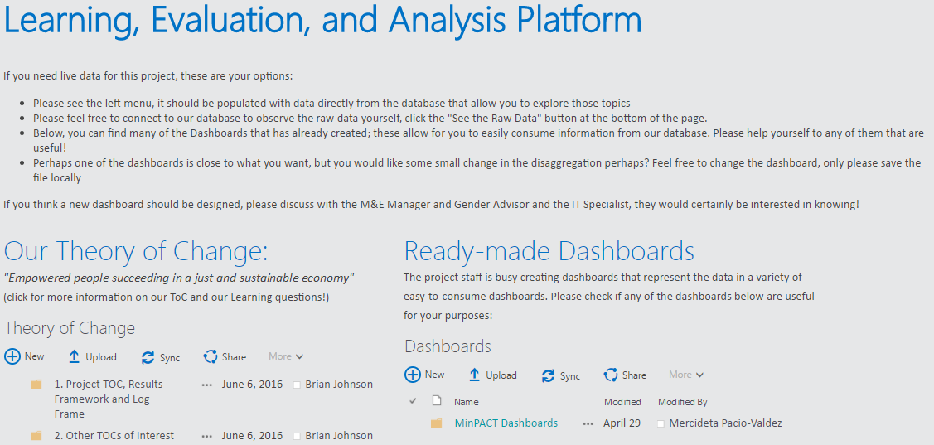
LEAP Landing Page – Theory of Change

Slide 21
LEAP Landing Page – Dashboards

Slide 22

LEAP Landing Page – Learning & Impacts

Slide 23
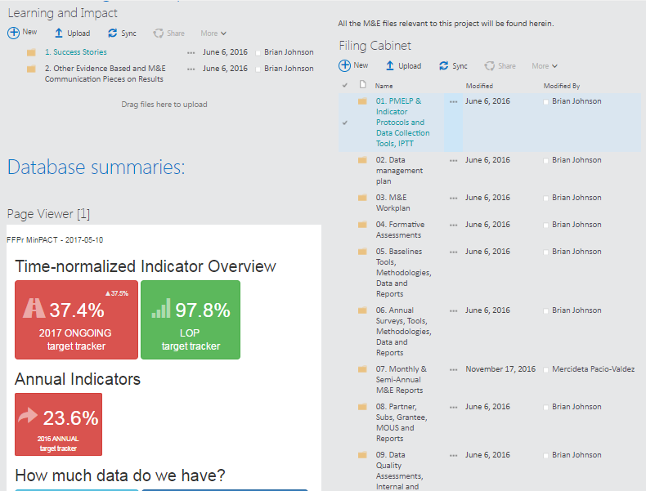
LEAP Landing Page – Filing Cabinet

Slide 24
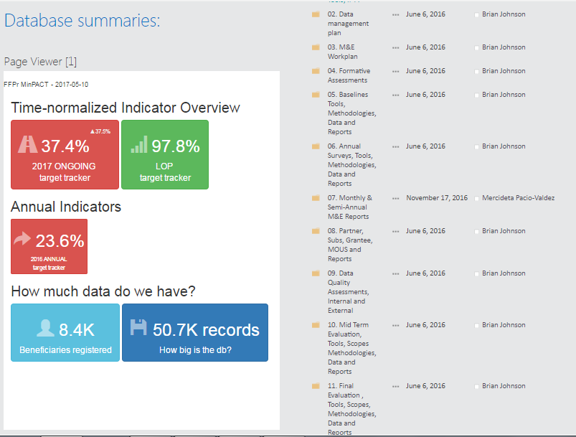
LEAP Landing Page – Database Summaries
Top-level view of all project data
Measurement according to current year’s time lapse

Slide 25
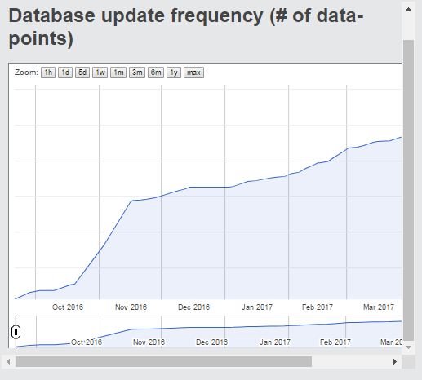
LEAP Landing Page – Database Updates
Flow of information arriving into the MIS
If activities are being implemented, data should be increasing
Flat lines are meaningful, but not always bad!

Slide 26
Indicator Tally & Bullet Chart

Slide 27
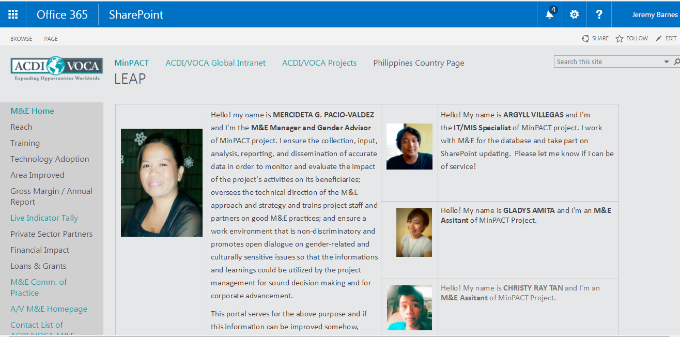
Indicator Tally – Navigation
Click Live Indicator Tally

Slide 28
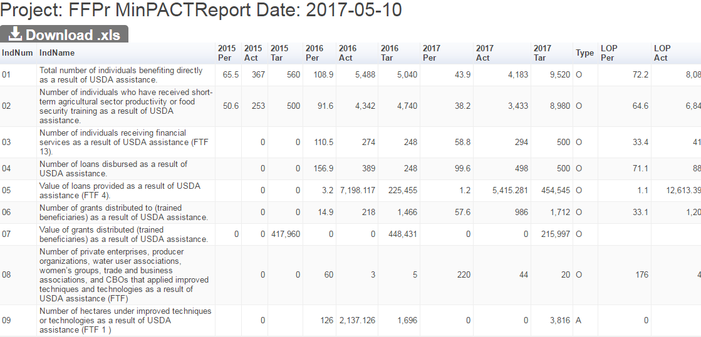
Indicator Tally – Automated IPTT
Get Excel Copy
Note the date of calculation!
Indicators and performance (target, actual, % achieved) by FY and LoP

Slide 29
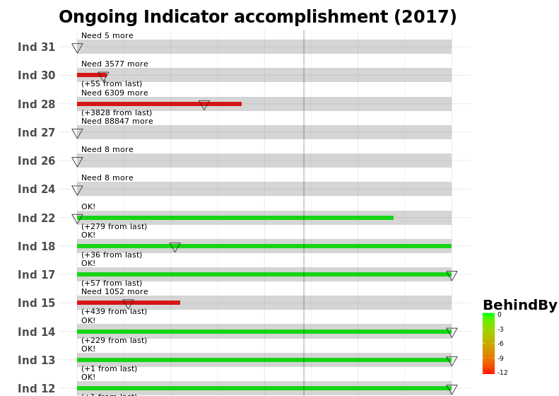
Indicator Tally – Automated IPTT
Output achievement with time lapse
How much is needed to be “current”
Status 2 weeks ago
Value added last 2 weeks

Slide 30
Indicator Tally – Interpretation
Target achievement is not always linear, so slow movement not always a sign of bad performance!
Examples:
Some activities may be planned for later in the year (slow for several months then a surge)
Situation on the ground halts activities

Slide 31
What do we need from project staff?
Upload ALL data
Work with us to ensure automated queries are correct
Use it! ☺

Slide 32
M&E Deliverables
Follow-up on M&E Obligations
Hard:
Contractual Obligations (Annual Report, Database created, …)
Soft:
Intermediate goals for Hard deadlines
Action Point items: (DQA findings, MIS findings, …)
Database here!

Slide 33
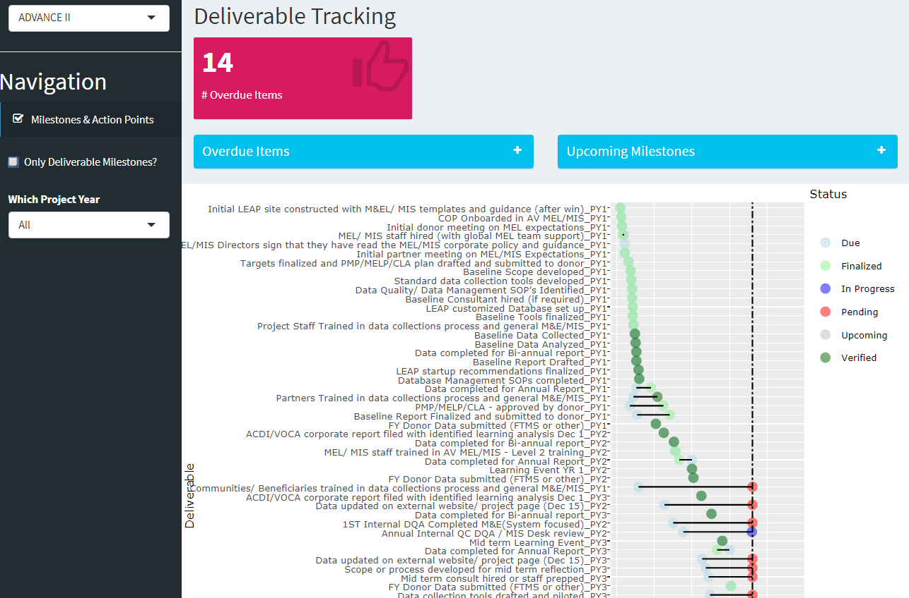
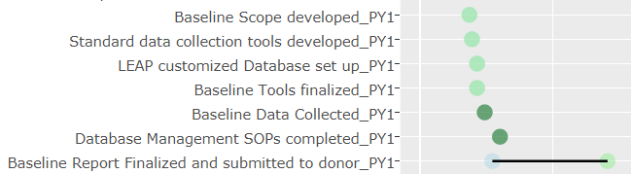
Project selector
Soft/Hard Deadlines
PY selector
Milestone Timeline

Slide 34
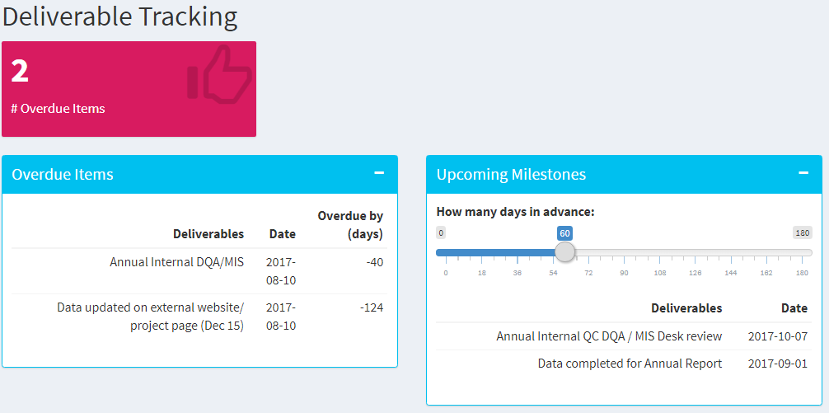

Slide 35
What do we need from project staff?
Upload all deliverables to Filing Cabinet
Ensure Due dates are correct
Ensure Milestones “apply”
Enter in when deliverables are “In-progress” & “Finalized”
Use it! ☺

Slide 36
Future initiatives

Slide 37
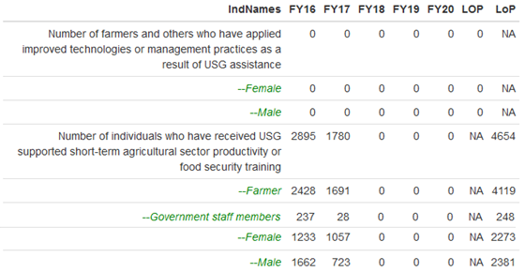
DISAGGREGATES IN AUTOMATED IPTT

Slide 38
Other Future initiatives
Quarterly Reports?
Power View → Power BI
Simplified calcs for Project Staff

Slide 39
Data Stories & Power BI demo

Slide 40
LEAP Summary
People = Project staff & HQ staff
Process = Trainings, DQAs, Backend updater
Tools = Project databases – Raw data, LEAP Sites, Dashboards, automated reports
OUR GOAL:
Everything you need to make decisions on your M&E data ->
Work planning, Adaptive Management, Proactive Adaptation

Slide 41
Small Group / Brainstorm
How can your team use LEAP assets
WEEKLY?
Missing anything? For example:

Slide 42
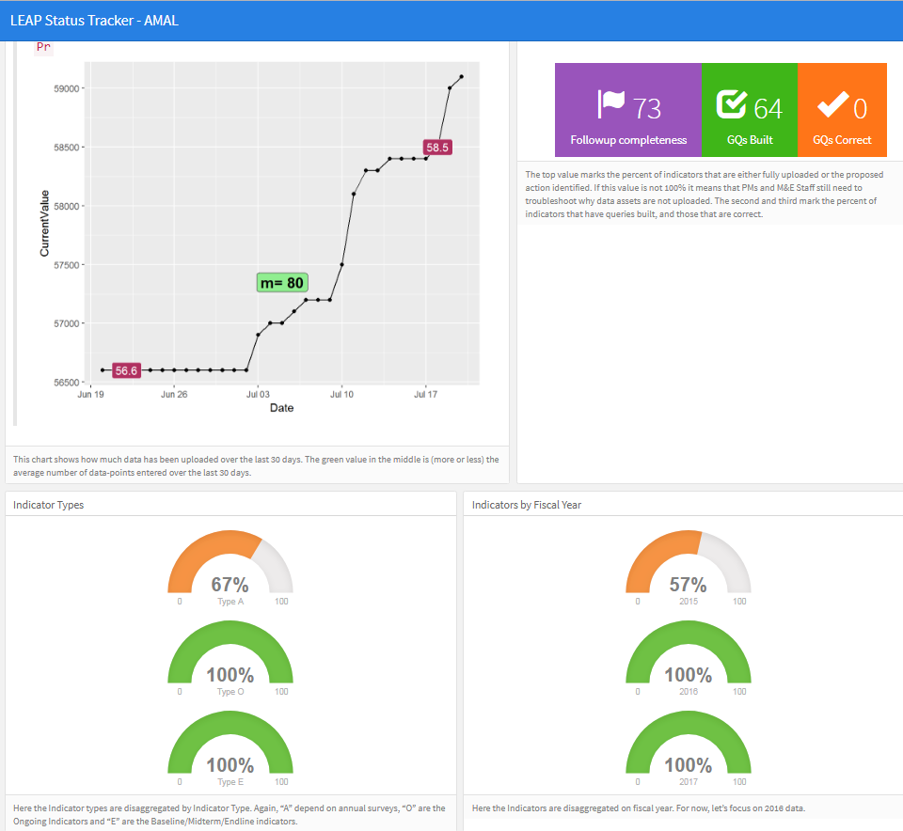
Example 1,
Data completeness report?

Slide 43
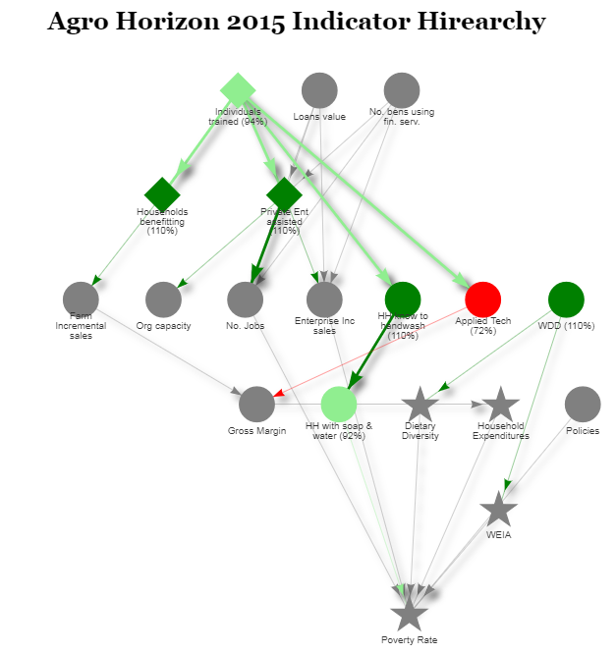
Example 2,
Full-Year Views

Slide 44
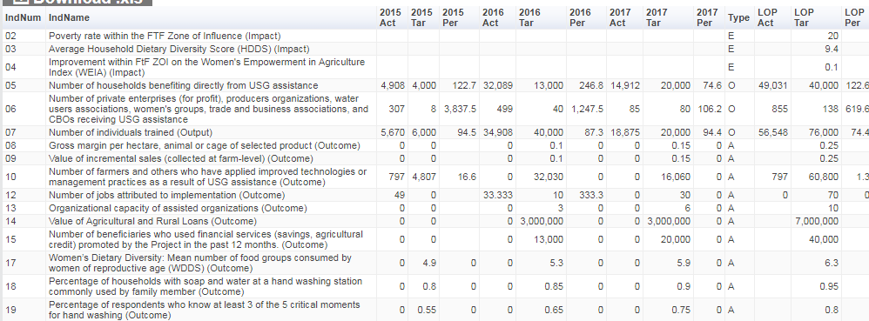
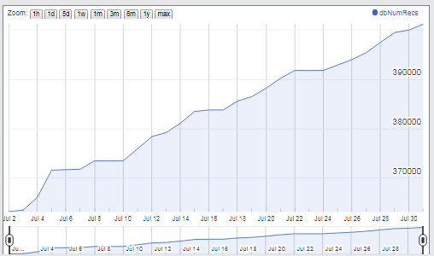
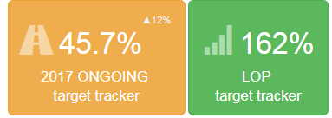
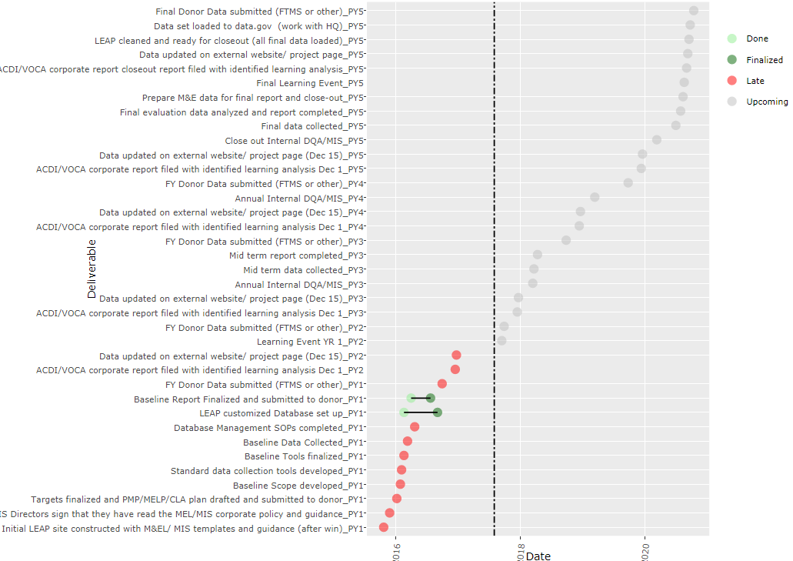
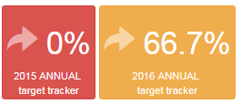
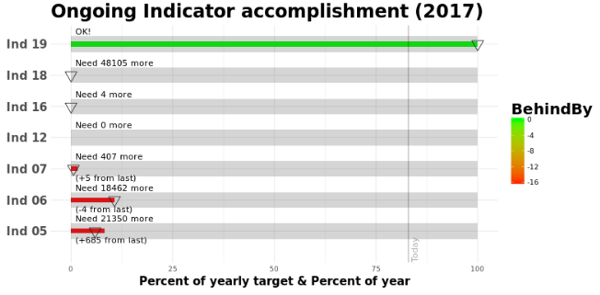
Current LEAP Automatic Assets
Data Uploads
Auto-IPTT
+ Project dashboards!
Indicator
Summaries
Milestone & Action Point Tracker
Indicator Performance
Indicator History?

Slide 45
Thanks!

